Slide 1

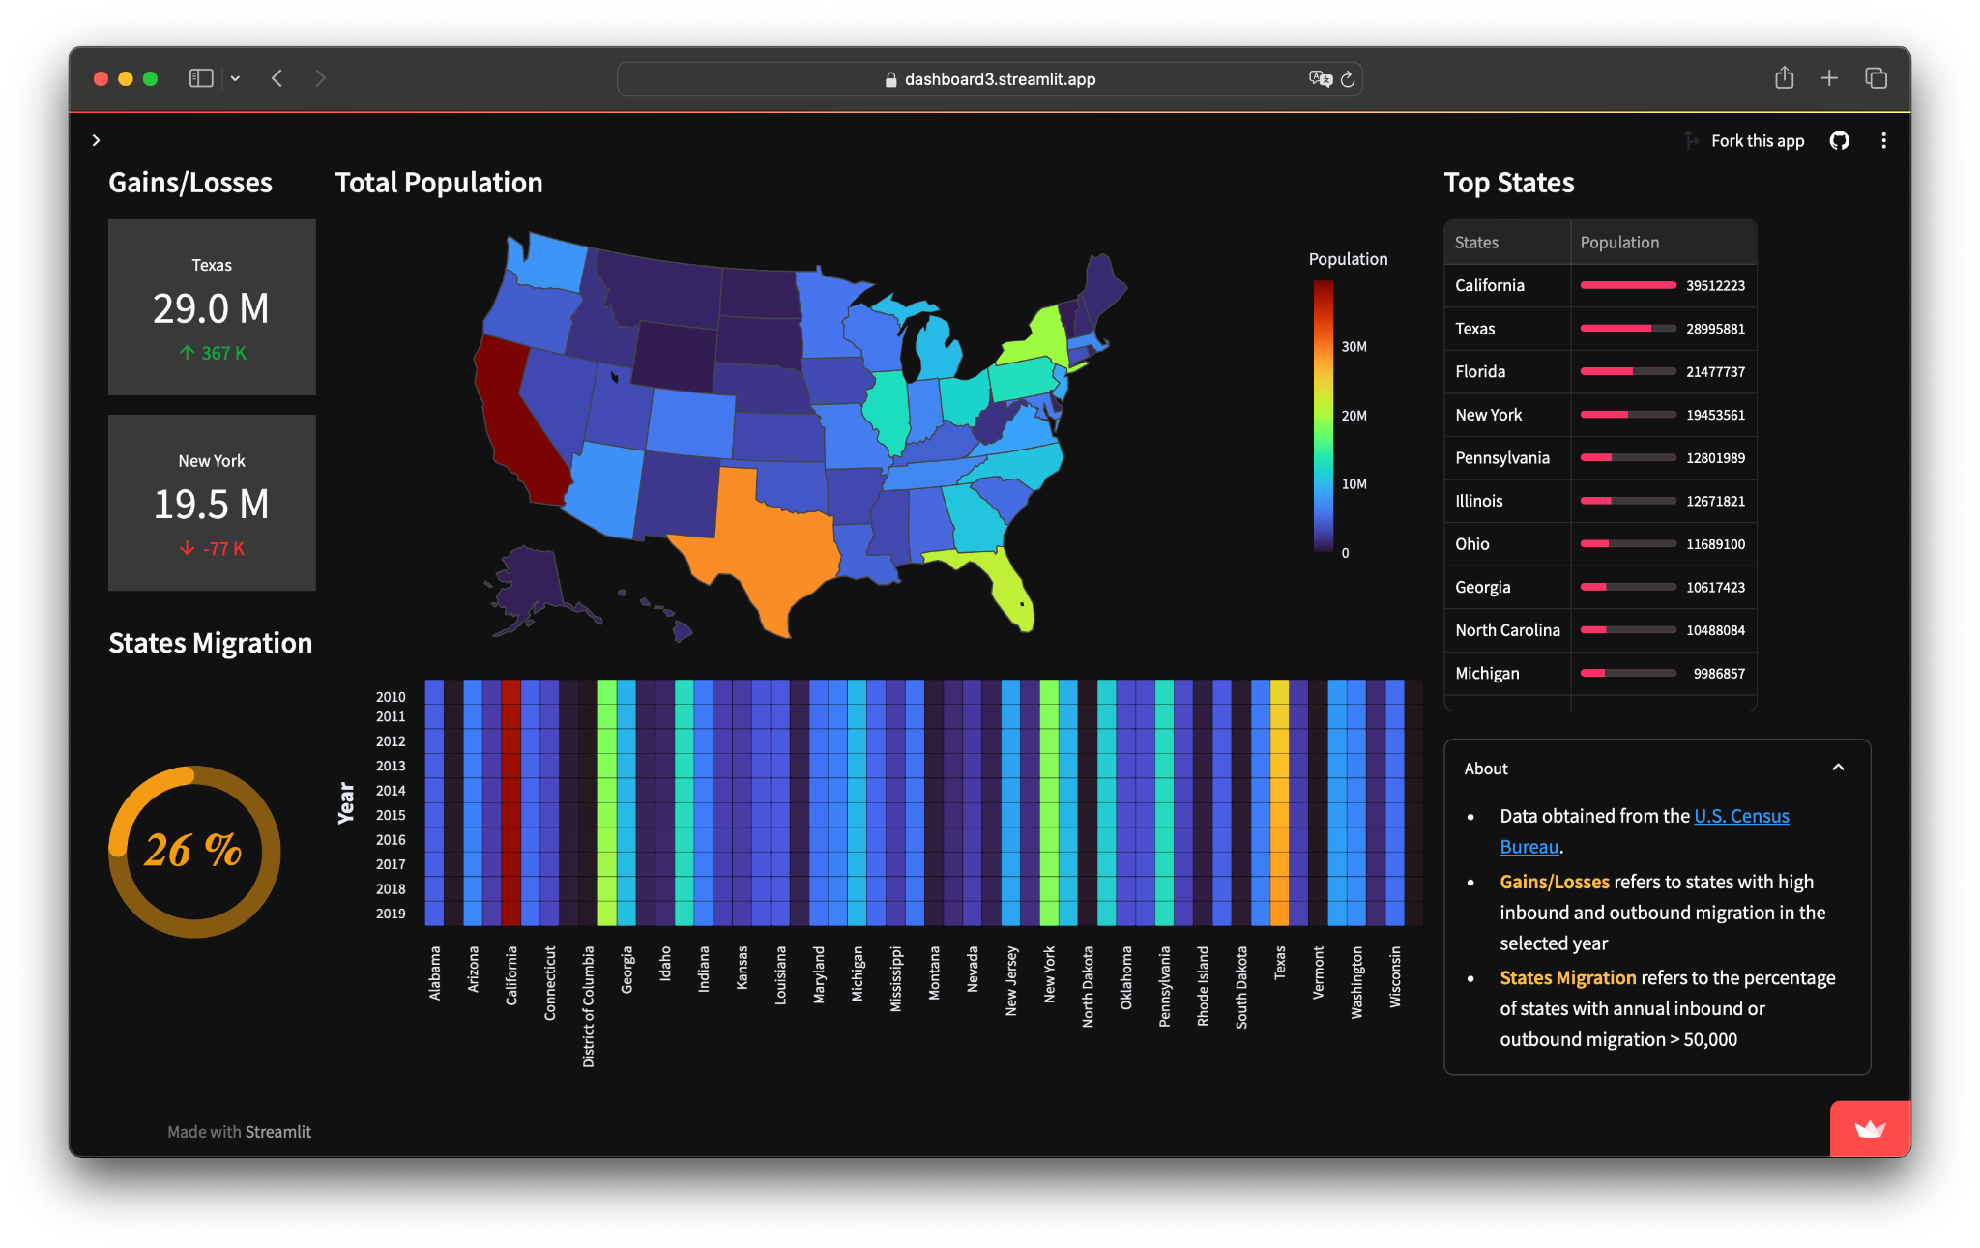
Crafting a
Dashboard
Python
in using

Slide 2
Importance of data
The ability to take data—to be able to understand it, to process it, to extract value from it, to visualize it, to communicate it—that’s going to be a hugely important skill in the next decades.
—Hal R. Varian, Google’s Chief Economist and UC Berkeley’s Emeritus Professor

Slide 3
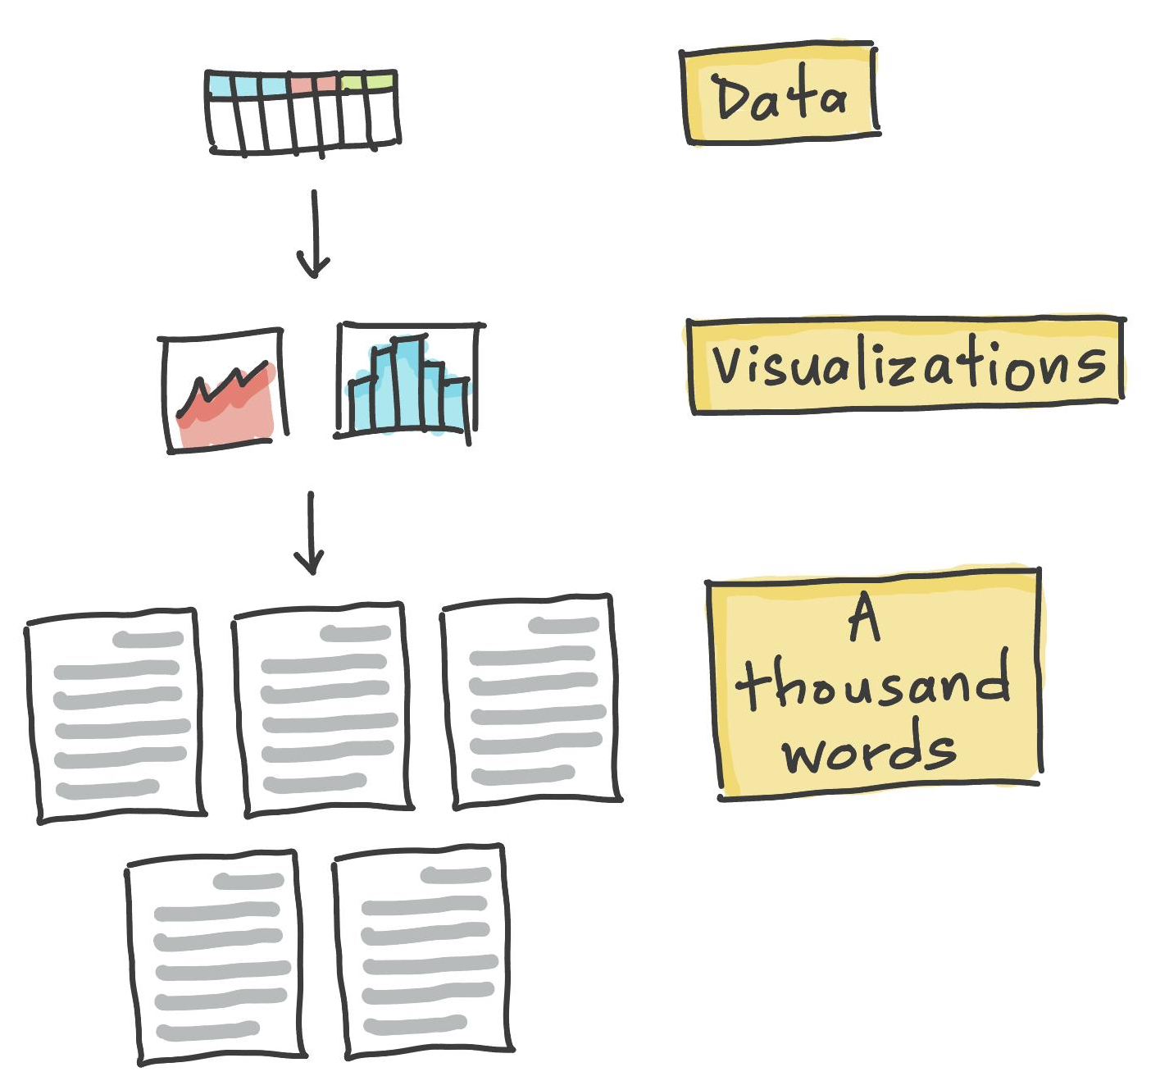
A picture is worth a thousand words
It follows that data visualization in the form of plot/chart/graph is just as powerful
Hence, this raises the importance of Data visualization
Data visualization distills key information from large datasets helping to quickly identify trends, outliers, and key insights as opposed to static tables

Slide 4
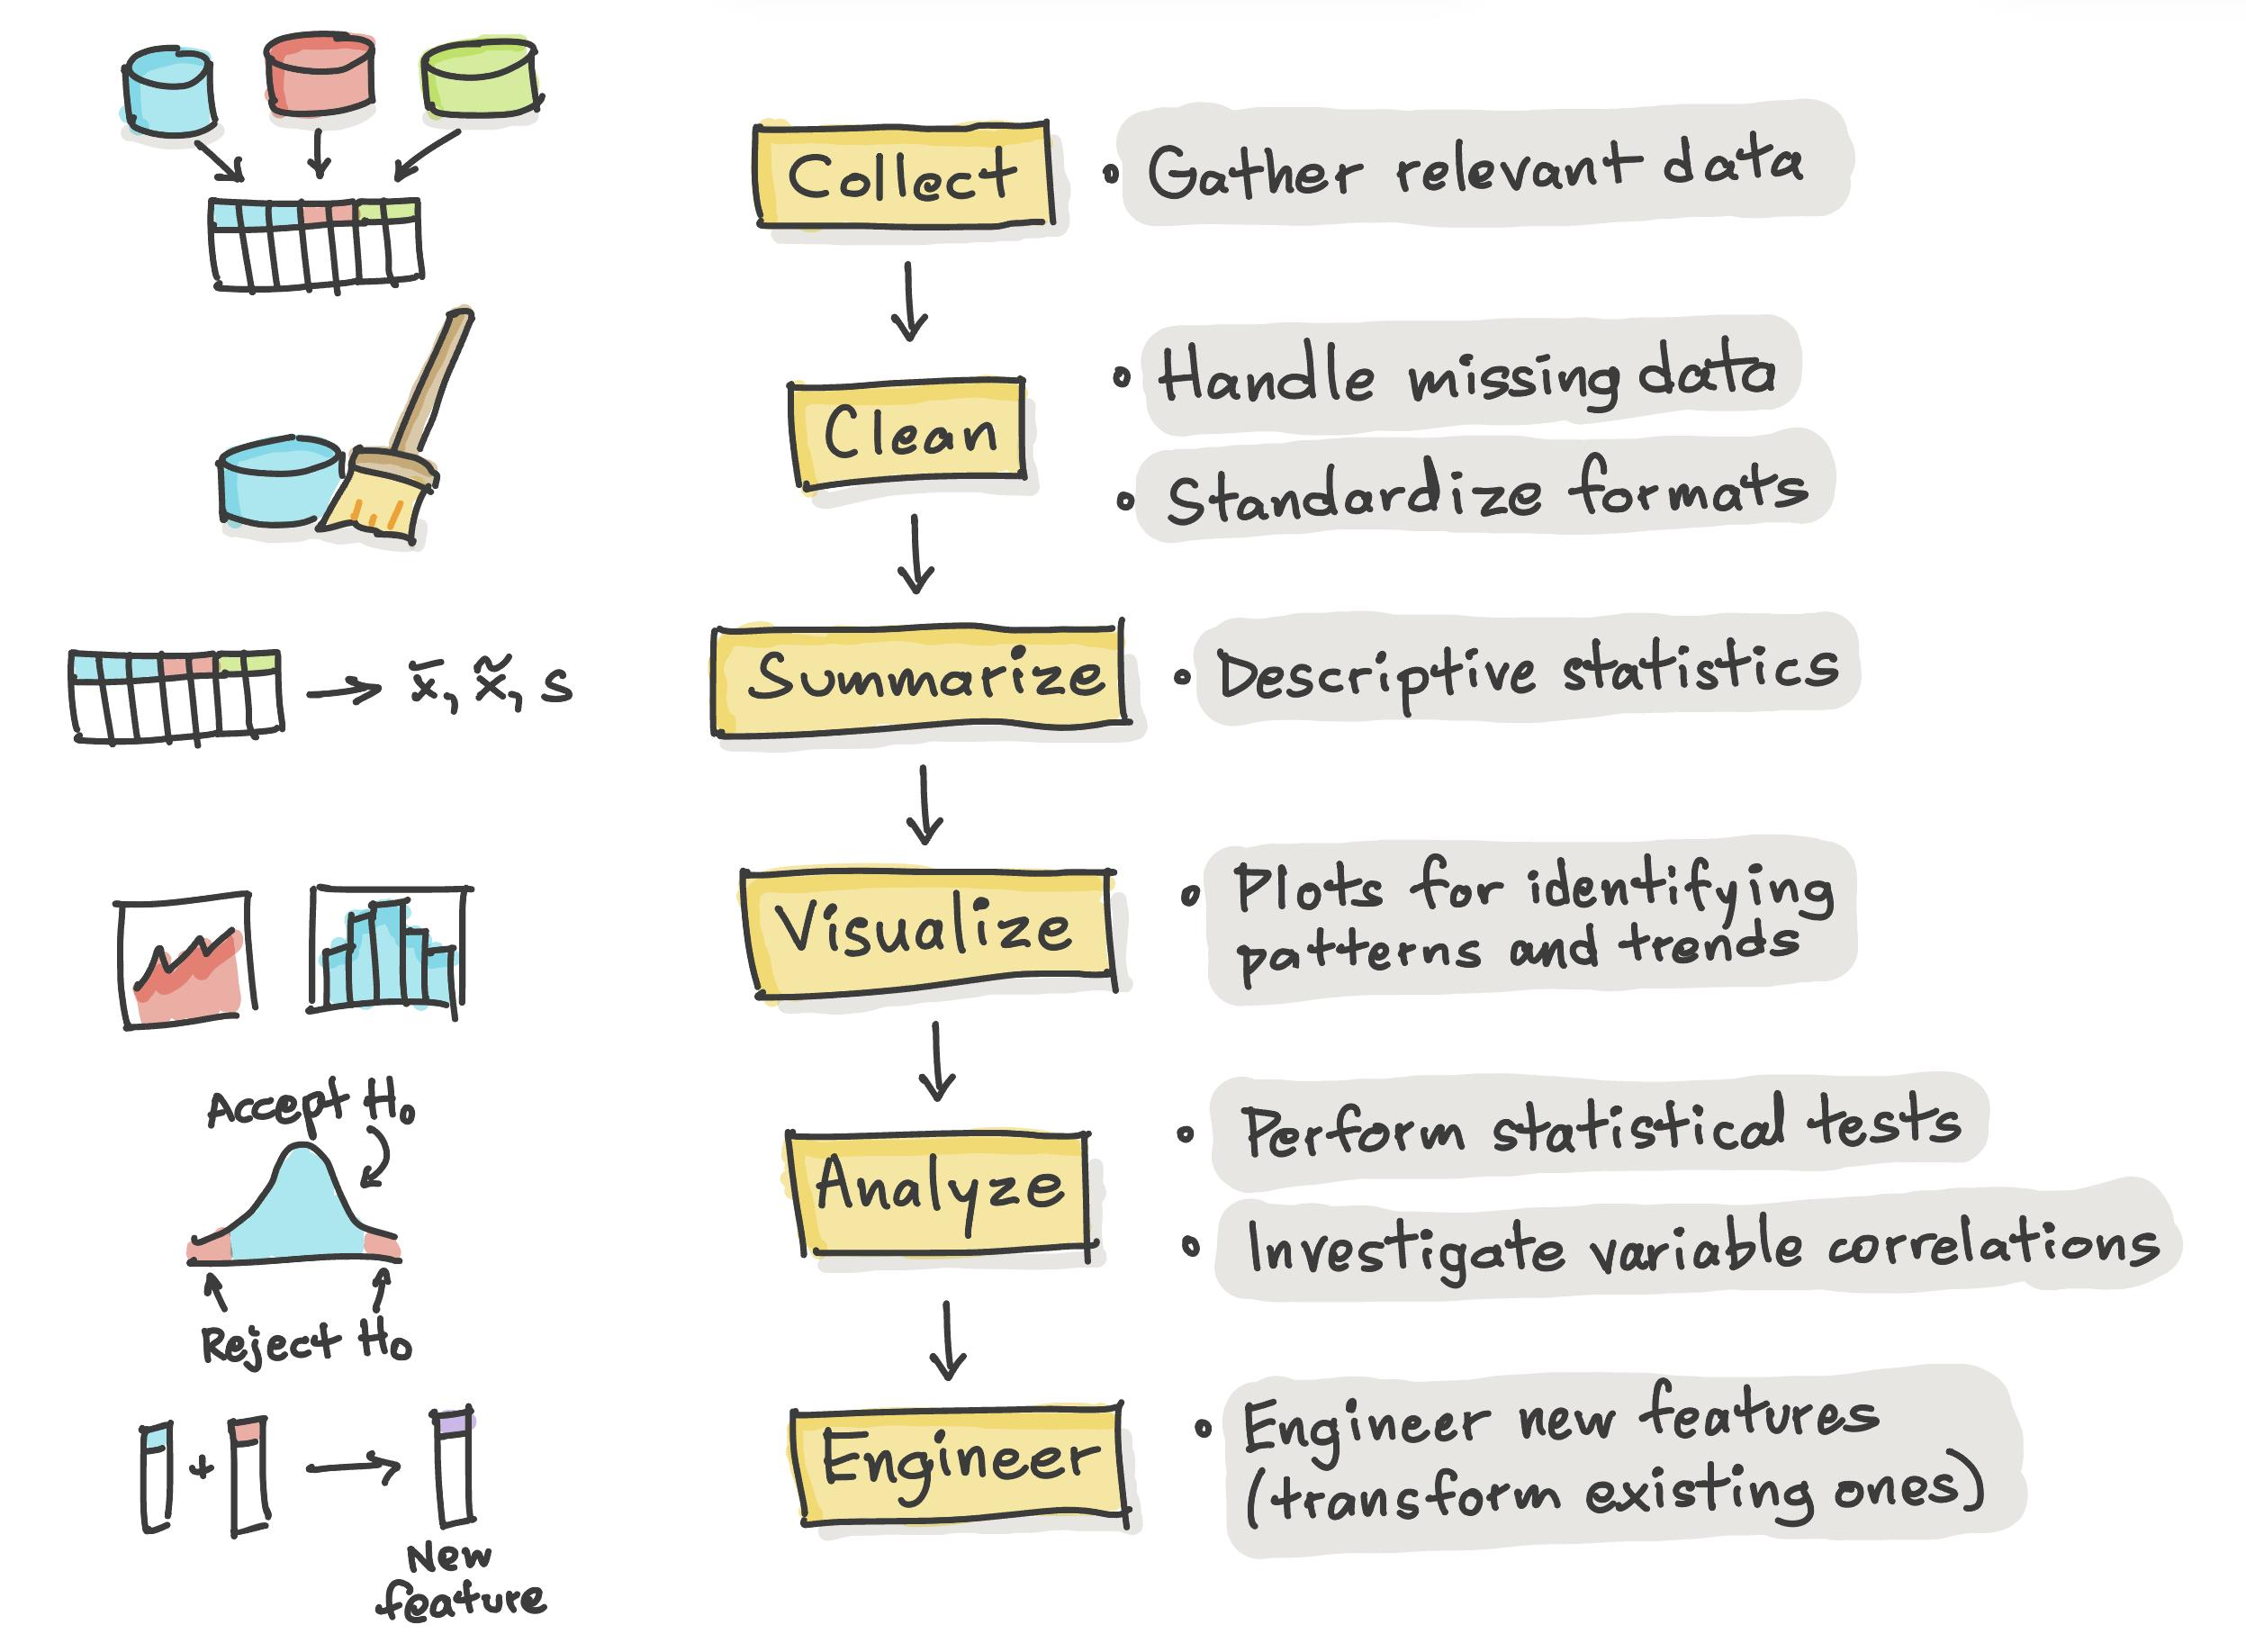
Exploratory Data Analysis (EDA)
EDA is a dynamic and iterative process for understanding the data
Summarize key characteristics of the data
Reveal patterns and trends in the data through the use of plots
Identify outliers that may lead to interesting insights

Slide 5
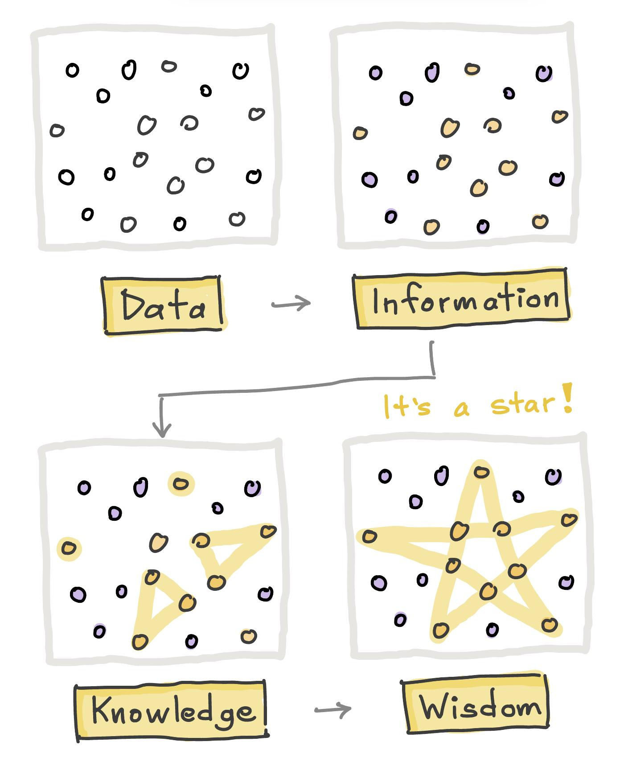
DIKW hierarchy
DIKW hierarchy pertains to the transform on raw data leading up to actionable insights
Data - Raw data without context
Information - Data has been organized and processed to provide context
Knowledge - Information is interpreted, analyzed, and connected
Wisdom - Application of knowledge to make sound decisions

Slide 6
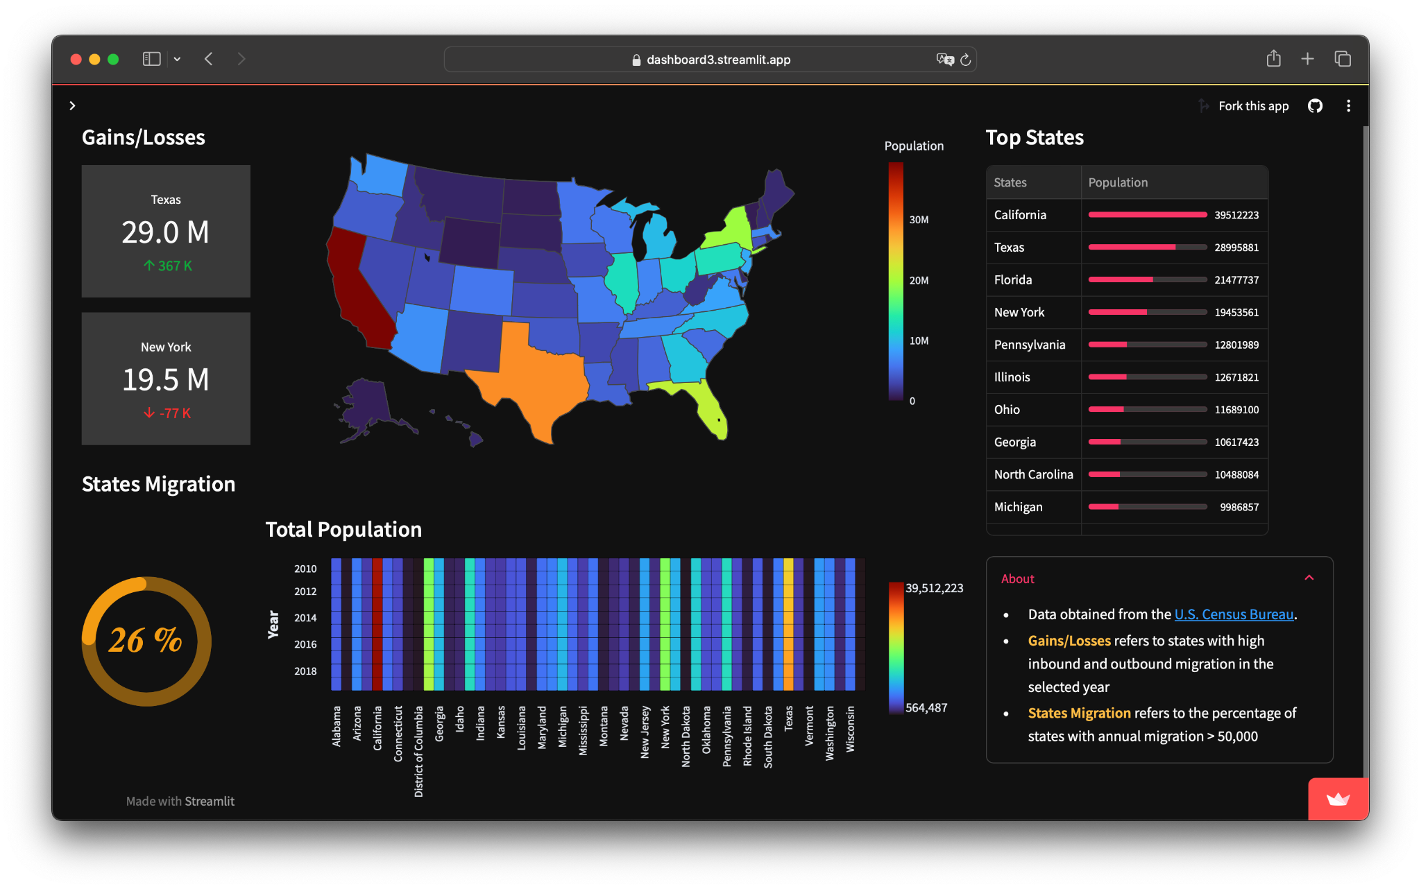
Importance of Dashboards
Simplifies complex data to easy to understand visual representation
Helps to identify patterns and trends in data
Enables real-time monitoring of key metrics
Helps to keep team and stakeholders aligned

Slide 7
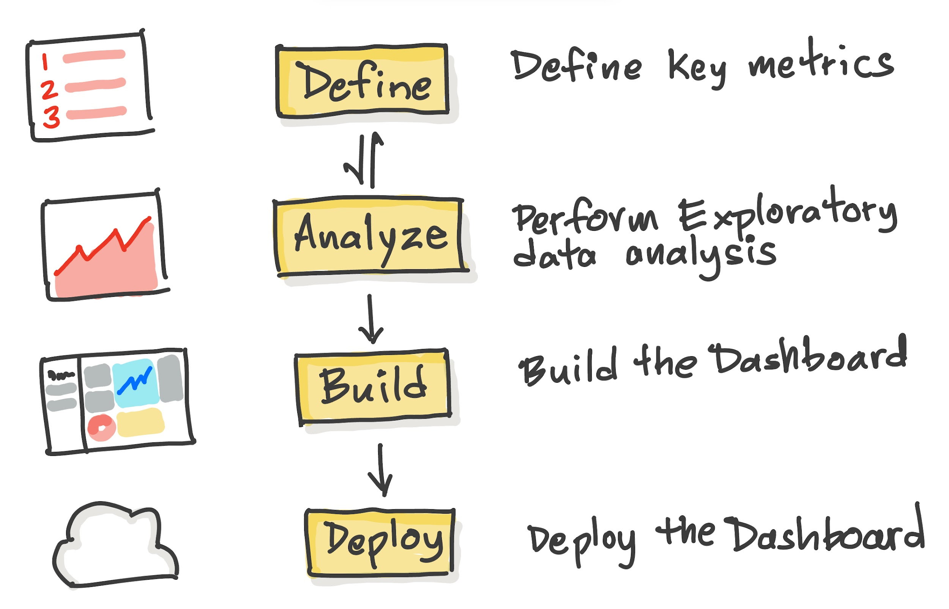
Process of Dashboard design
Having well-defined metrics helps to measure what matters
This can come from experience or from EDA analysis
Dashboard acts as the north star helping to stay on track

Slide 8

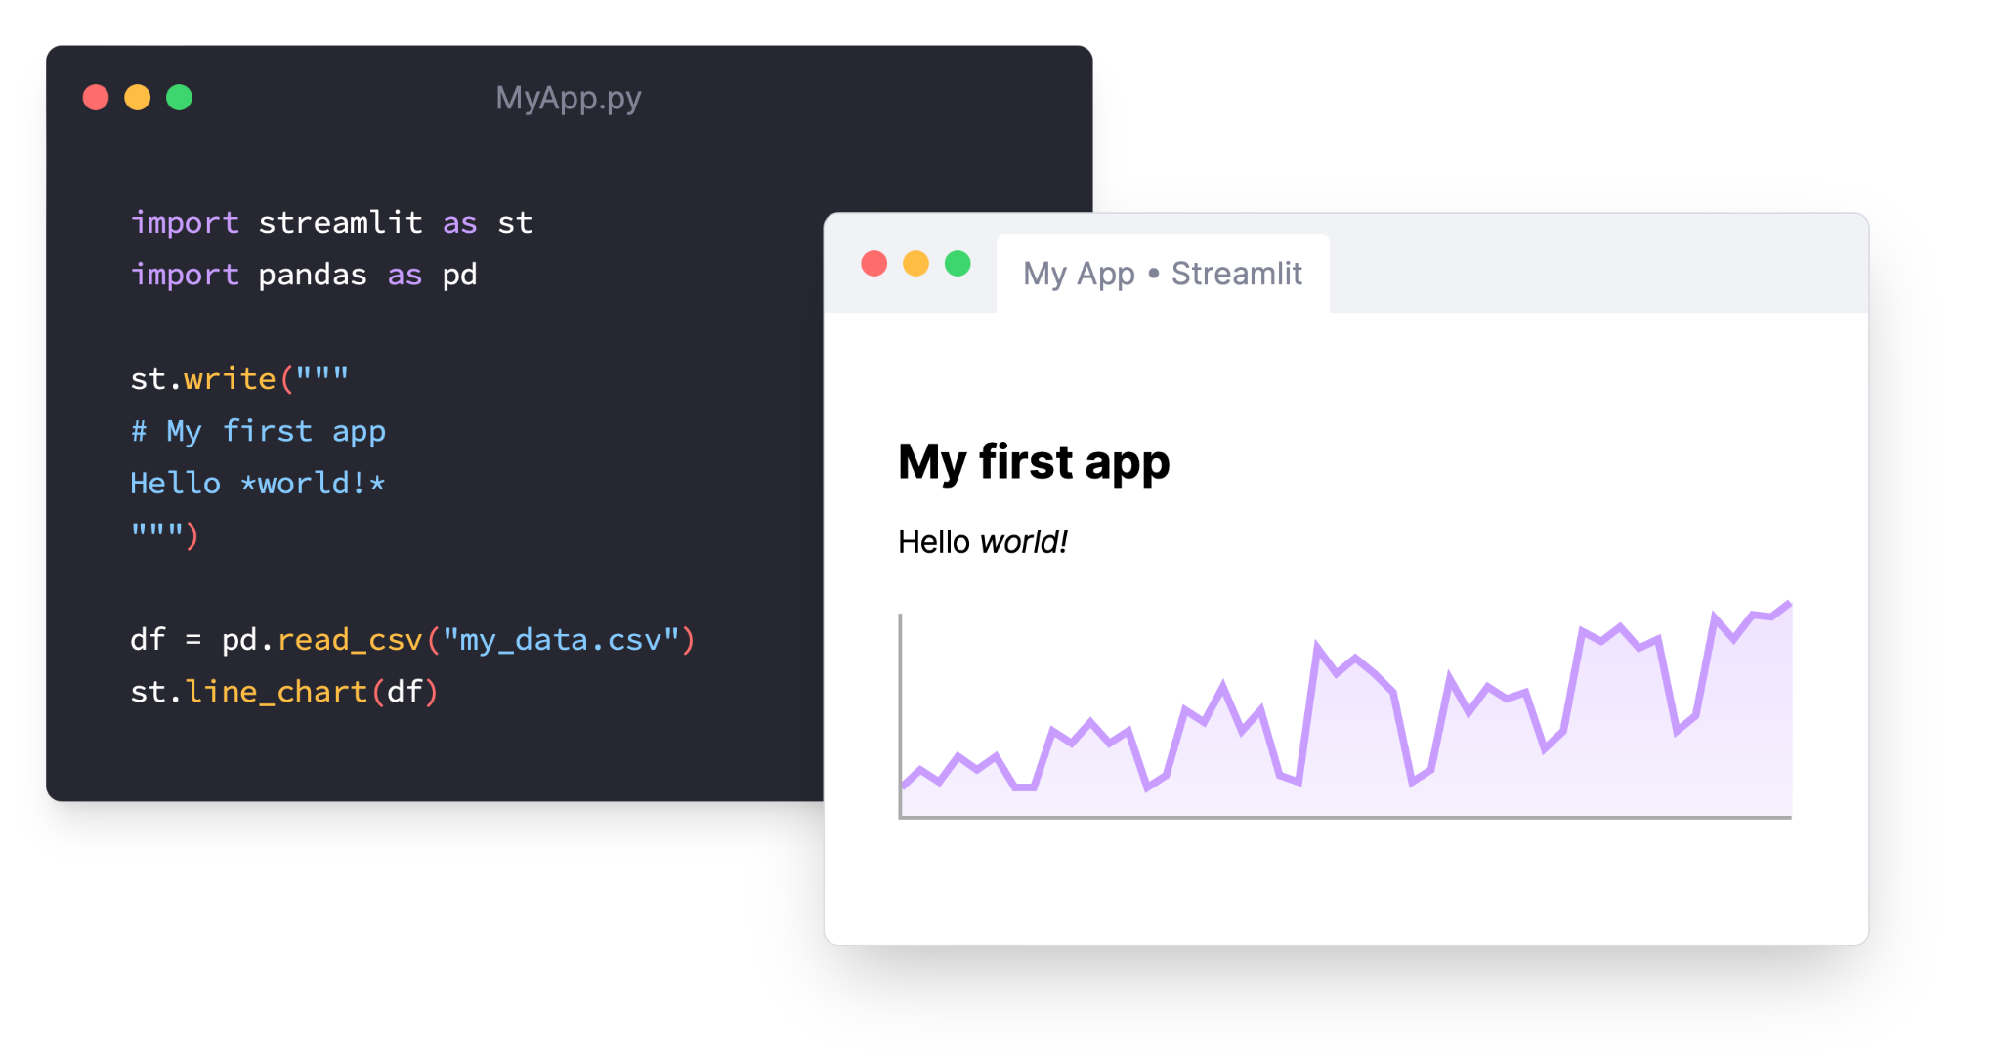
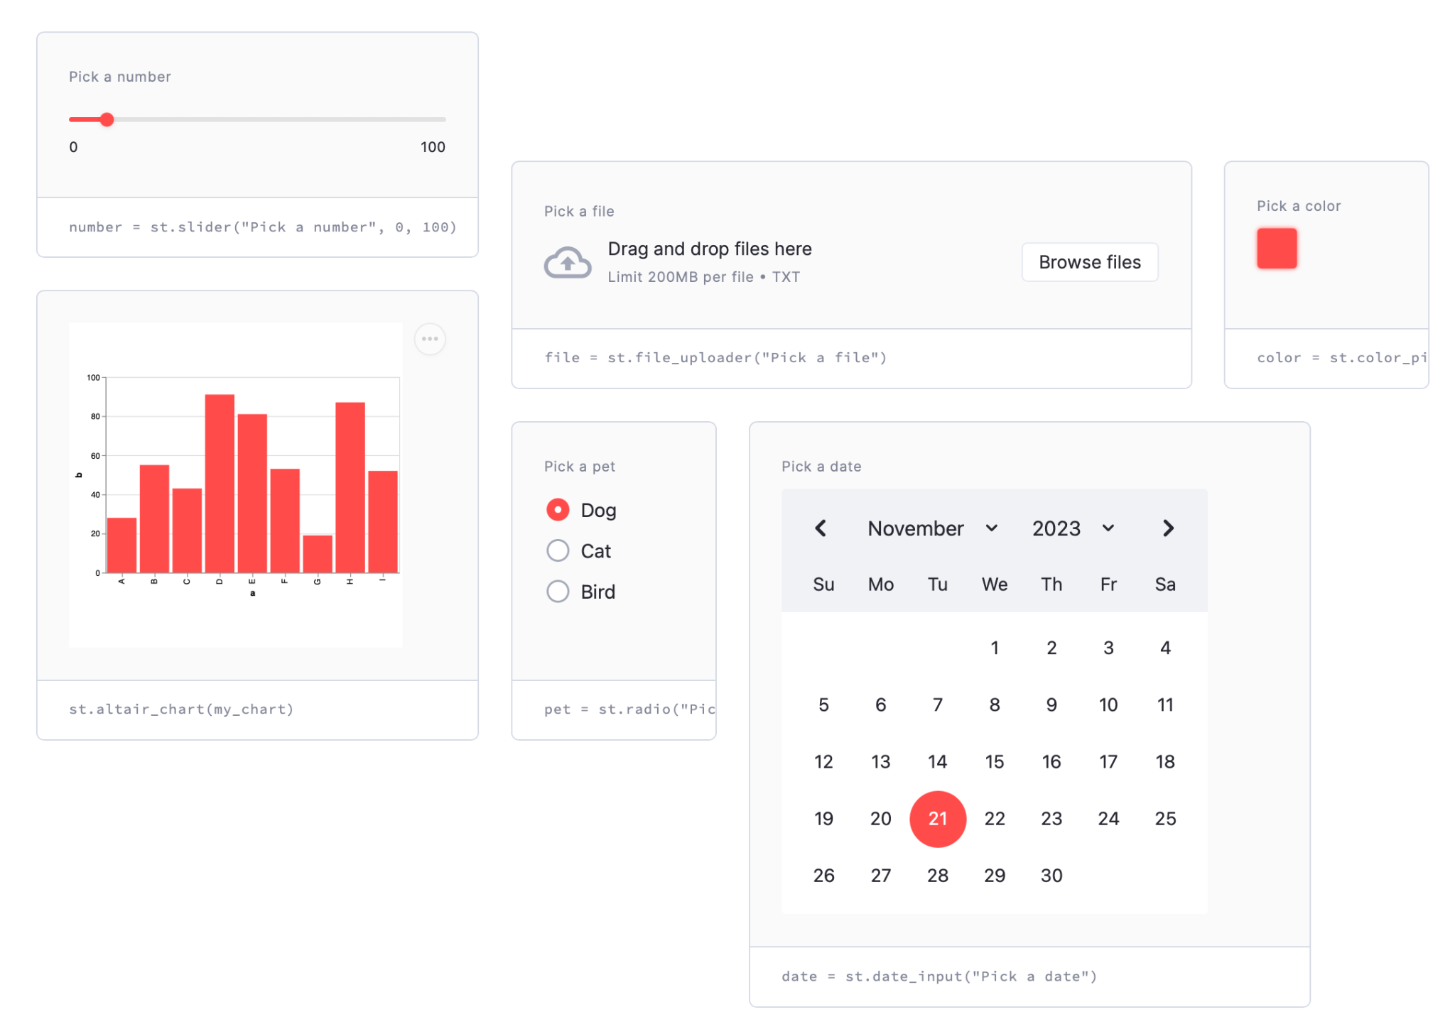
Why Streamlit?
Interactivity
Users can interact with widgets and instantly see its effect to data or plot
Users can get answers in a self-serve manner
Instant access to the app’s functionality
Users can instantly access the app’s functionality in-app
There‘s no need to spin up their own coding environment

Slide 9
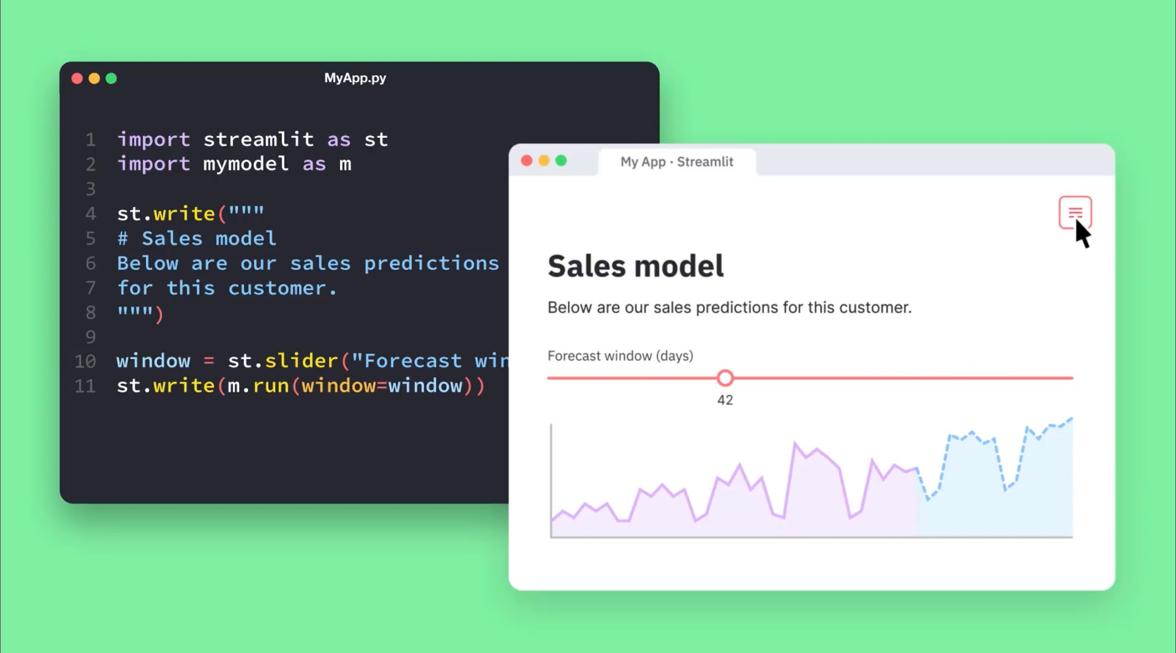
Enter Streamlit …
Streamlit is an open source web framework in Python that turns data scripts into shareable web apps in minutes
Typically, creating web apps require a steep learning curve
Streamlit requires no front-end experience (as this is already handled by Streamlit) so you can focus on the data and model

Slide 10
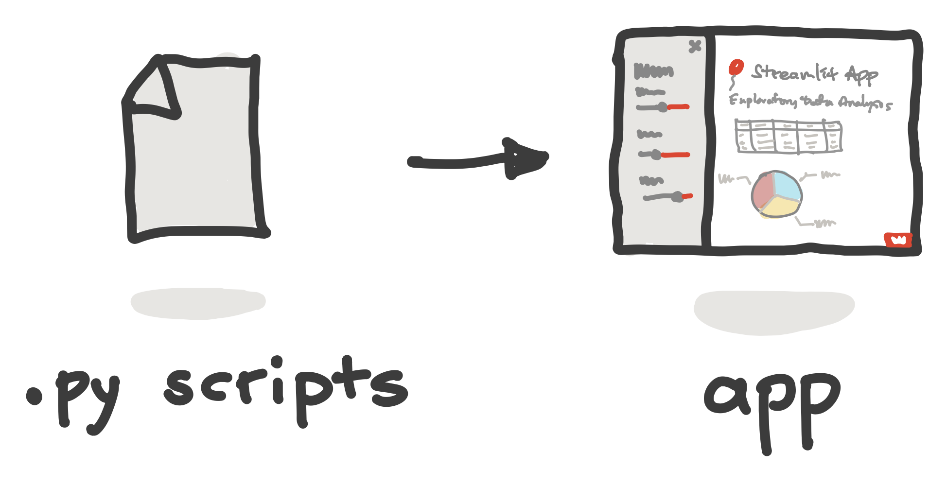
It’s fast and easy to build web apps
To build a web app you’d typically use such Python web frameworks as Django and Flask
But the steep learning curve and the big time investment for implementing these apps present a major hurdle
Streamlit makes the app creation process as simple as writing Python scripts

Slide 11

Prerequisites
Have basic Python knowledge.
Write scripts to perform specific tasks
Taking several Excel files as input and combining them into one
Build and grow the Streamlit app line by line instead of starting with a predefined layout (it takes only a few lines of code)

Slide 12

Installing Streamlit
Streamlit can be installed via pip:
pip install streamlit
streamlit hello
Streamlit can be installed via conda:
conda install -c conda-forge streamlit

Slide 13
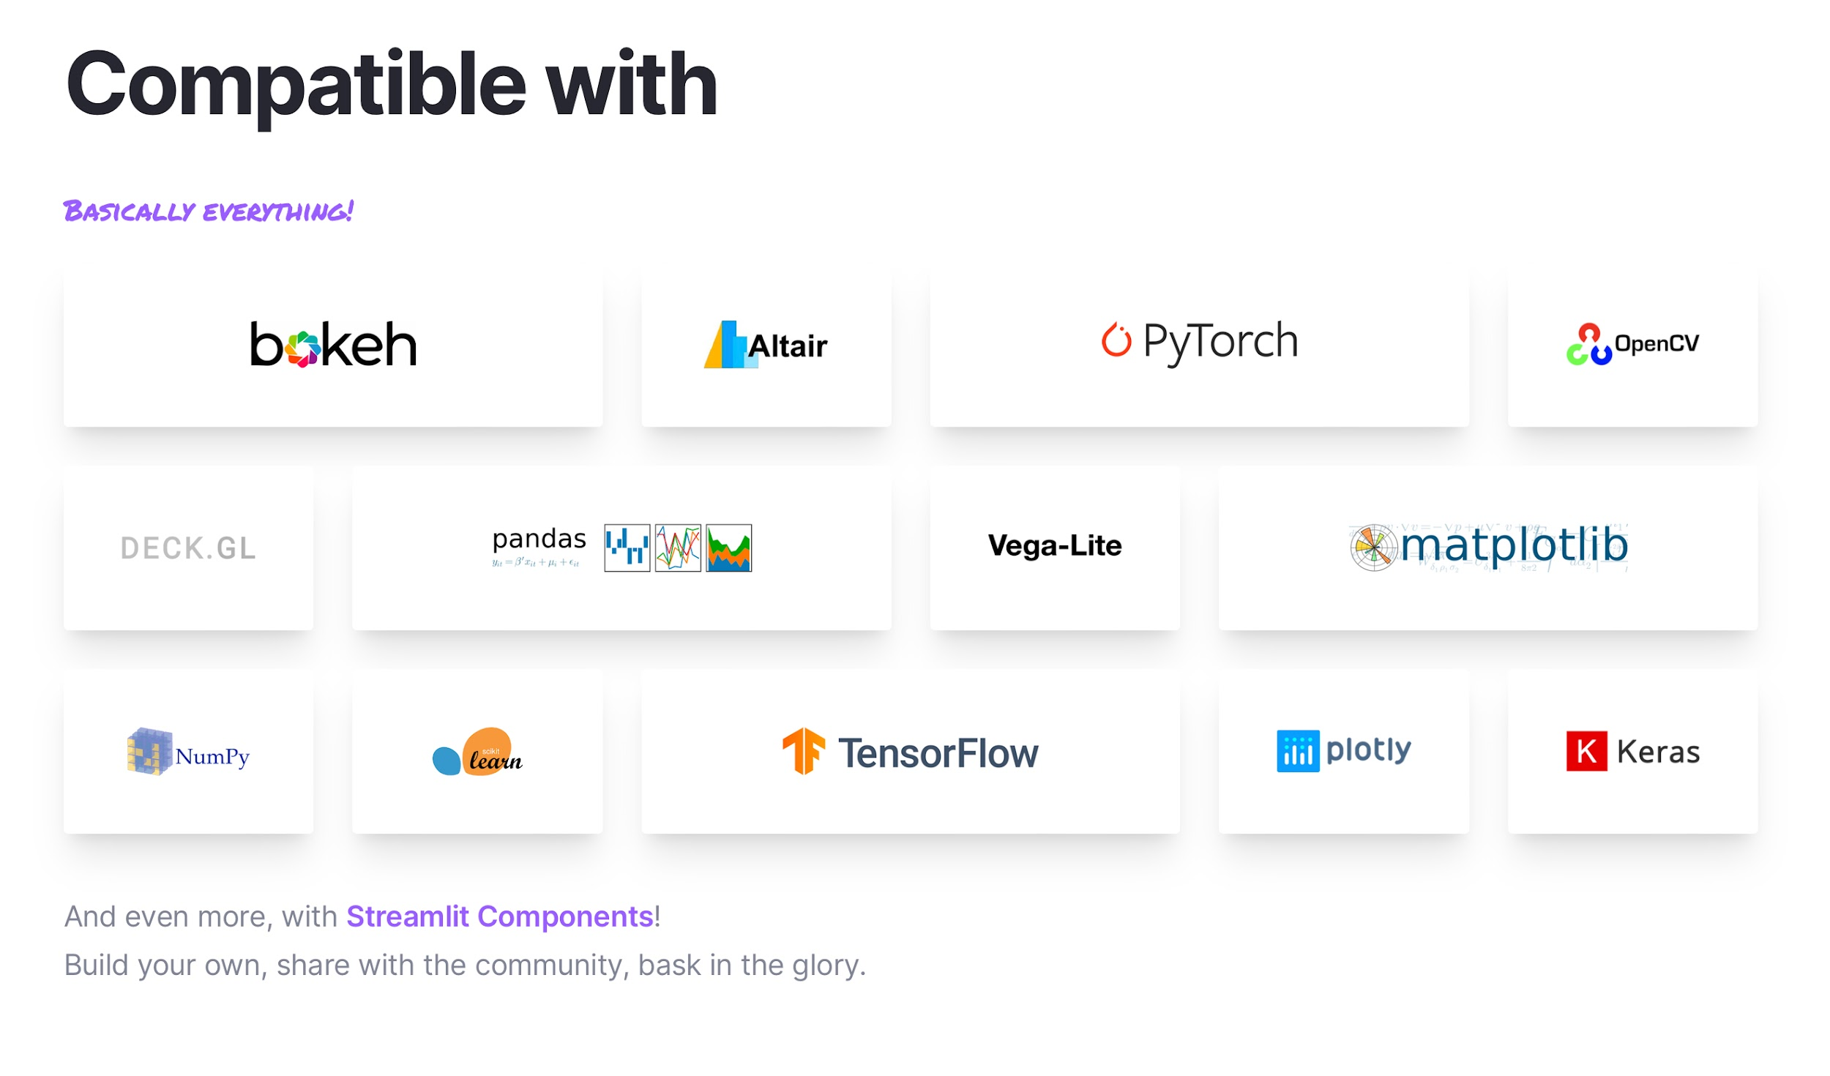
Python data ecosystem
The Python data ecosystem is comprised of several complementary Python libraries that facilitate the data science workflow

Slide 14
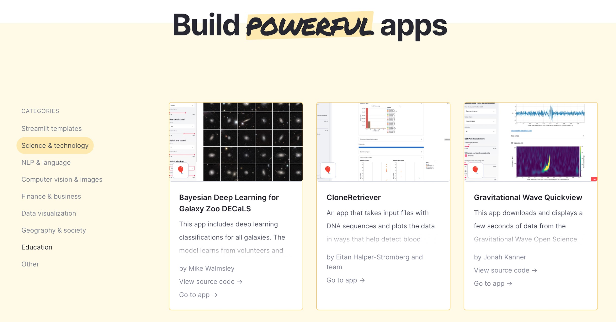
Gallery of Streamlit apps
If you’re looking to get inspired, you can check out the Gallery for examples of various Streamlit apps across several verticals

Slide 15
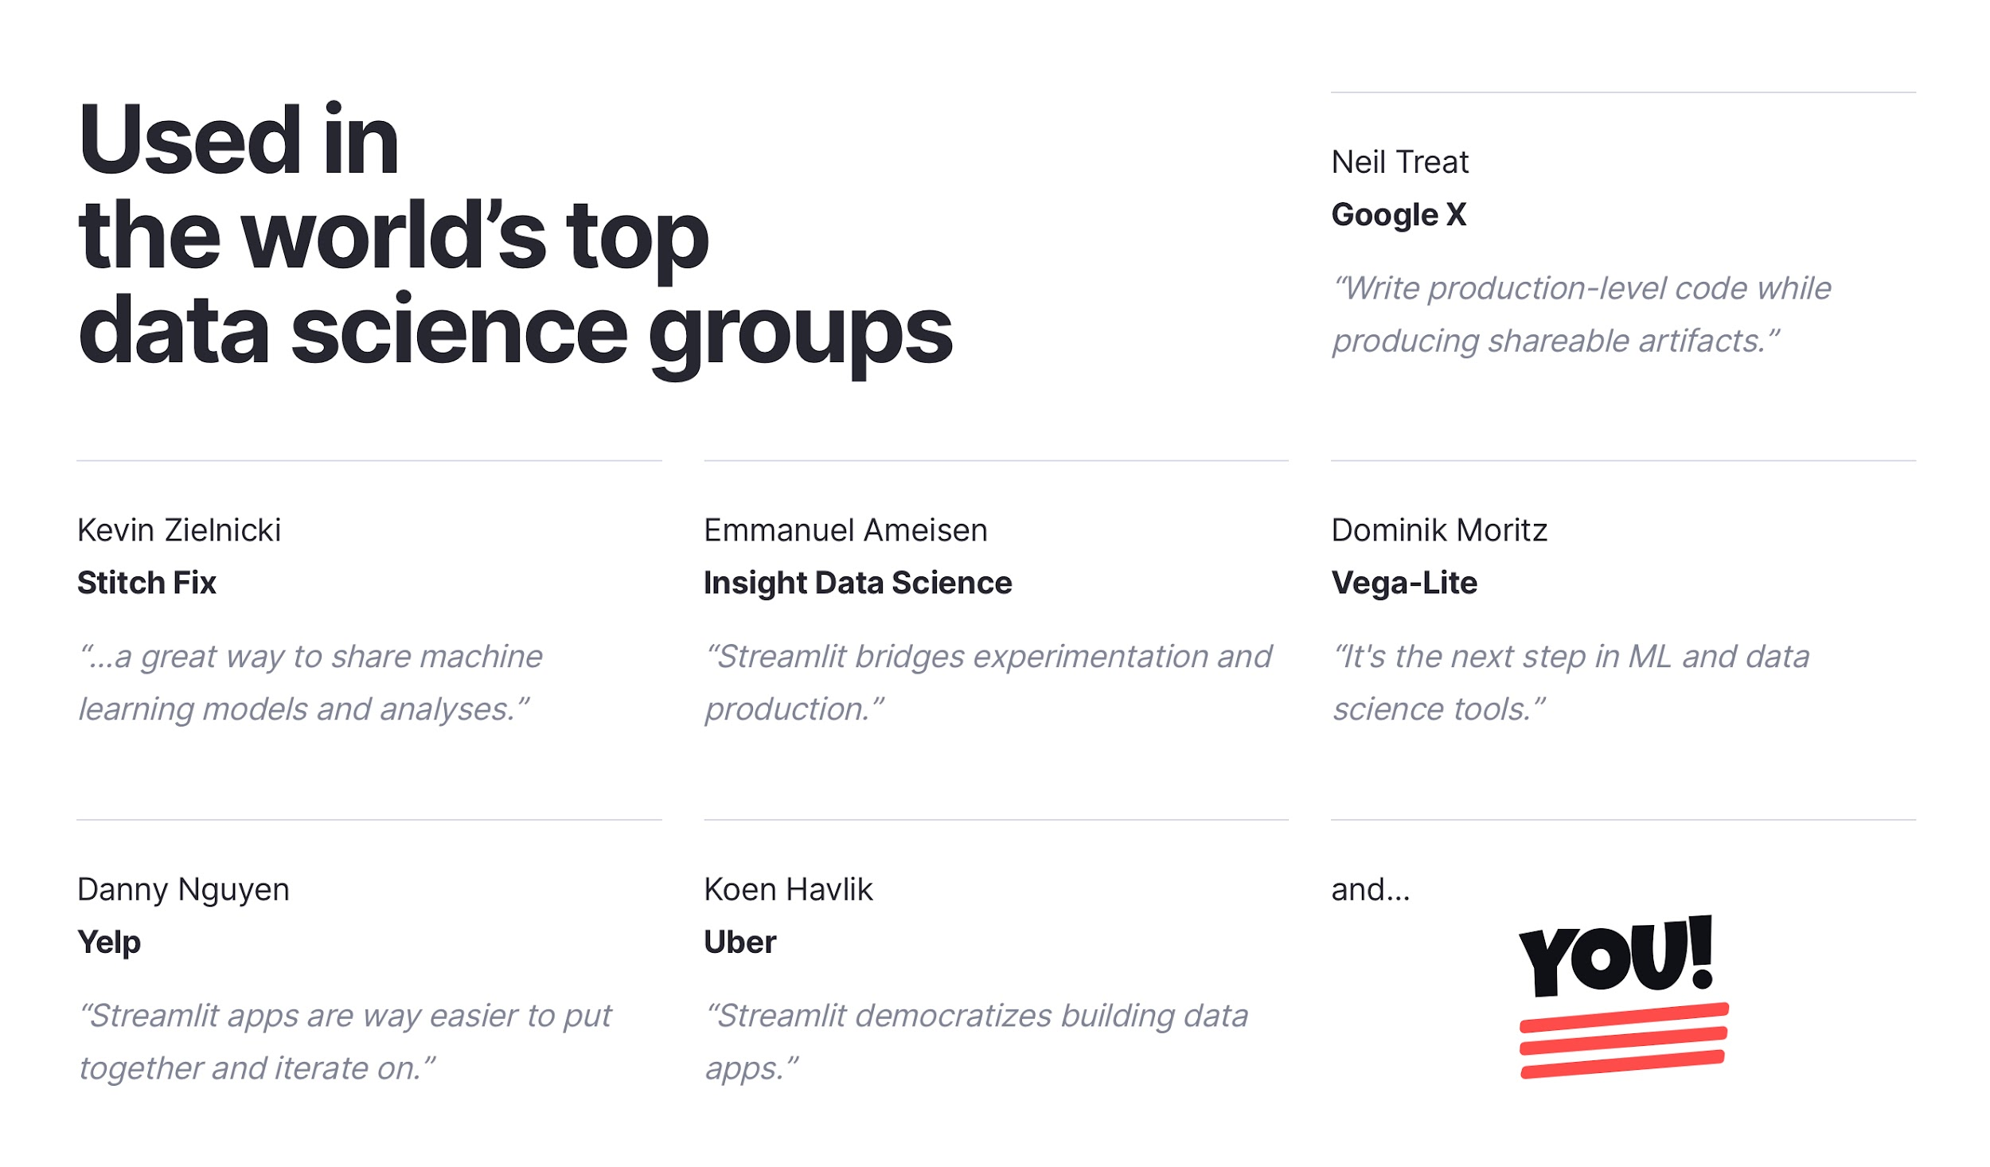
Streamlit for data science
Streamlit adds a visualization layer to scripts

Slide 16
3 simple principles of Streamlit
1. Embrace scripting
Build an app in a few lines of code with our magically simple API. Then see it automatically update as you iteratively save the source file.
2. Weave in interaction
Adding a widget is the same as declaring a variable. No need to write a backend, define routes, handle HTTP requests, connect a frontend, write HTML, CSS, JavaScript, ...
3. Deploy instantly
Effortlessly share, manage and deploy your apps, directly from Streamlit. All for free!

Slide 17

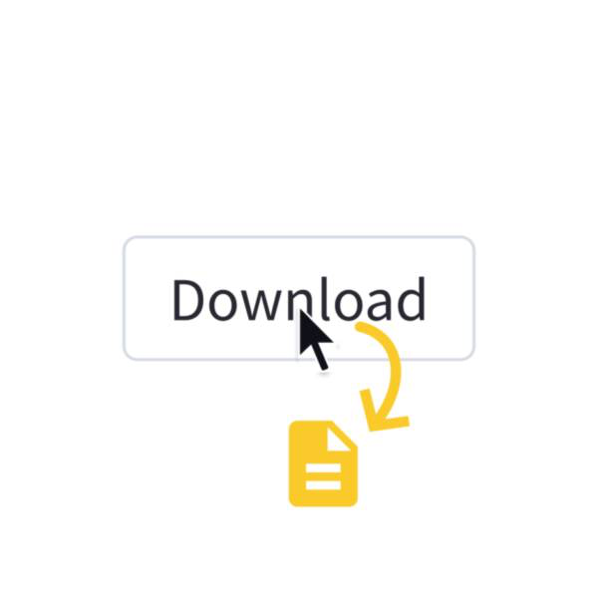
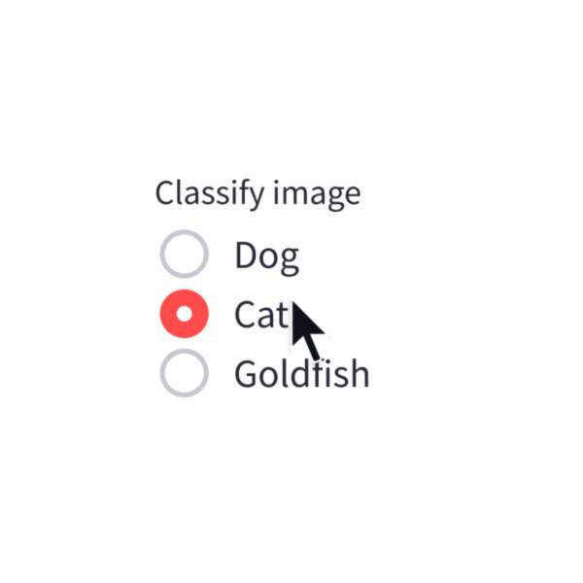
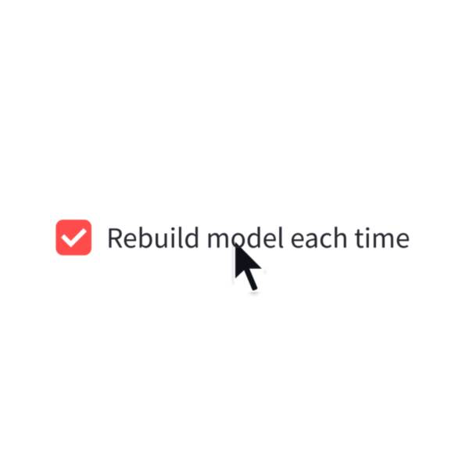
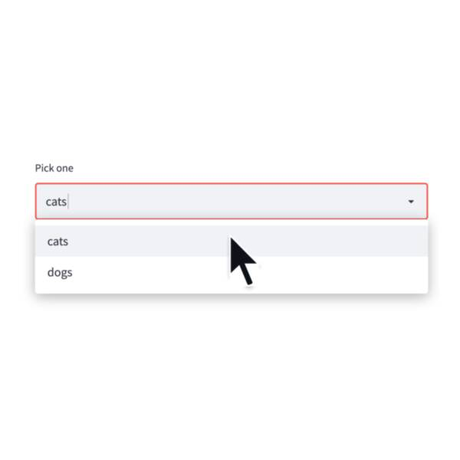
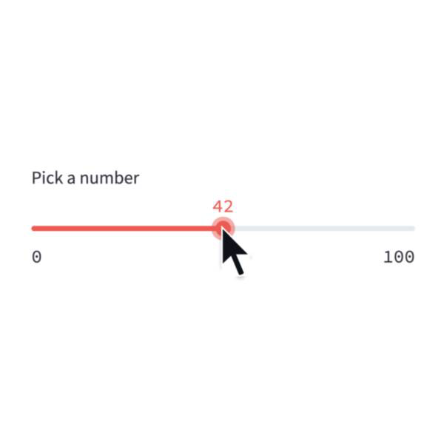
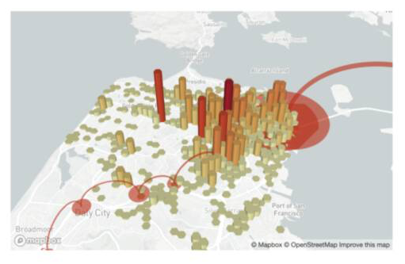
Coding a Streamlit app
A simple Streamlit app can start off as a single Python script file, e.g. app.py
Inside app file, you can import the Streamlit library via import streamlit as st and use any of the available Streamlit functions.
Input widgets
Output widgets

Slide 18
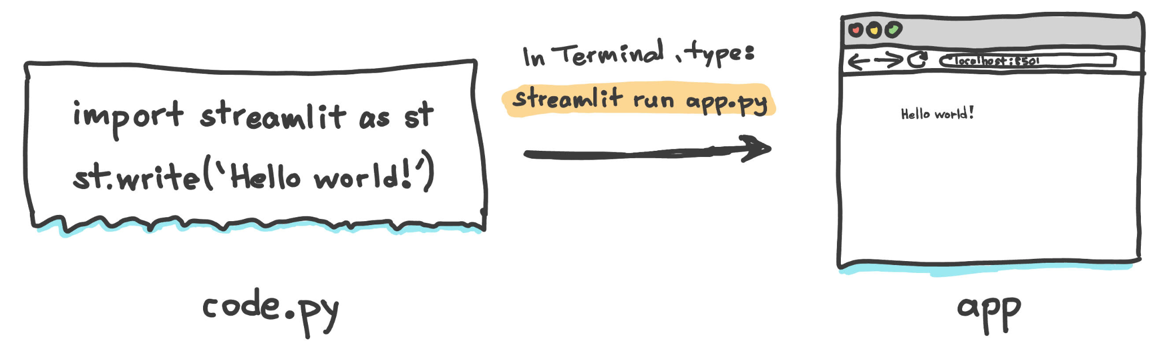
First Streamlit App
A minimal Streamlit app that prints Hello world!

Slide 19
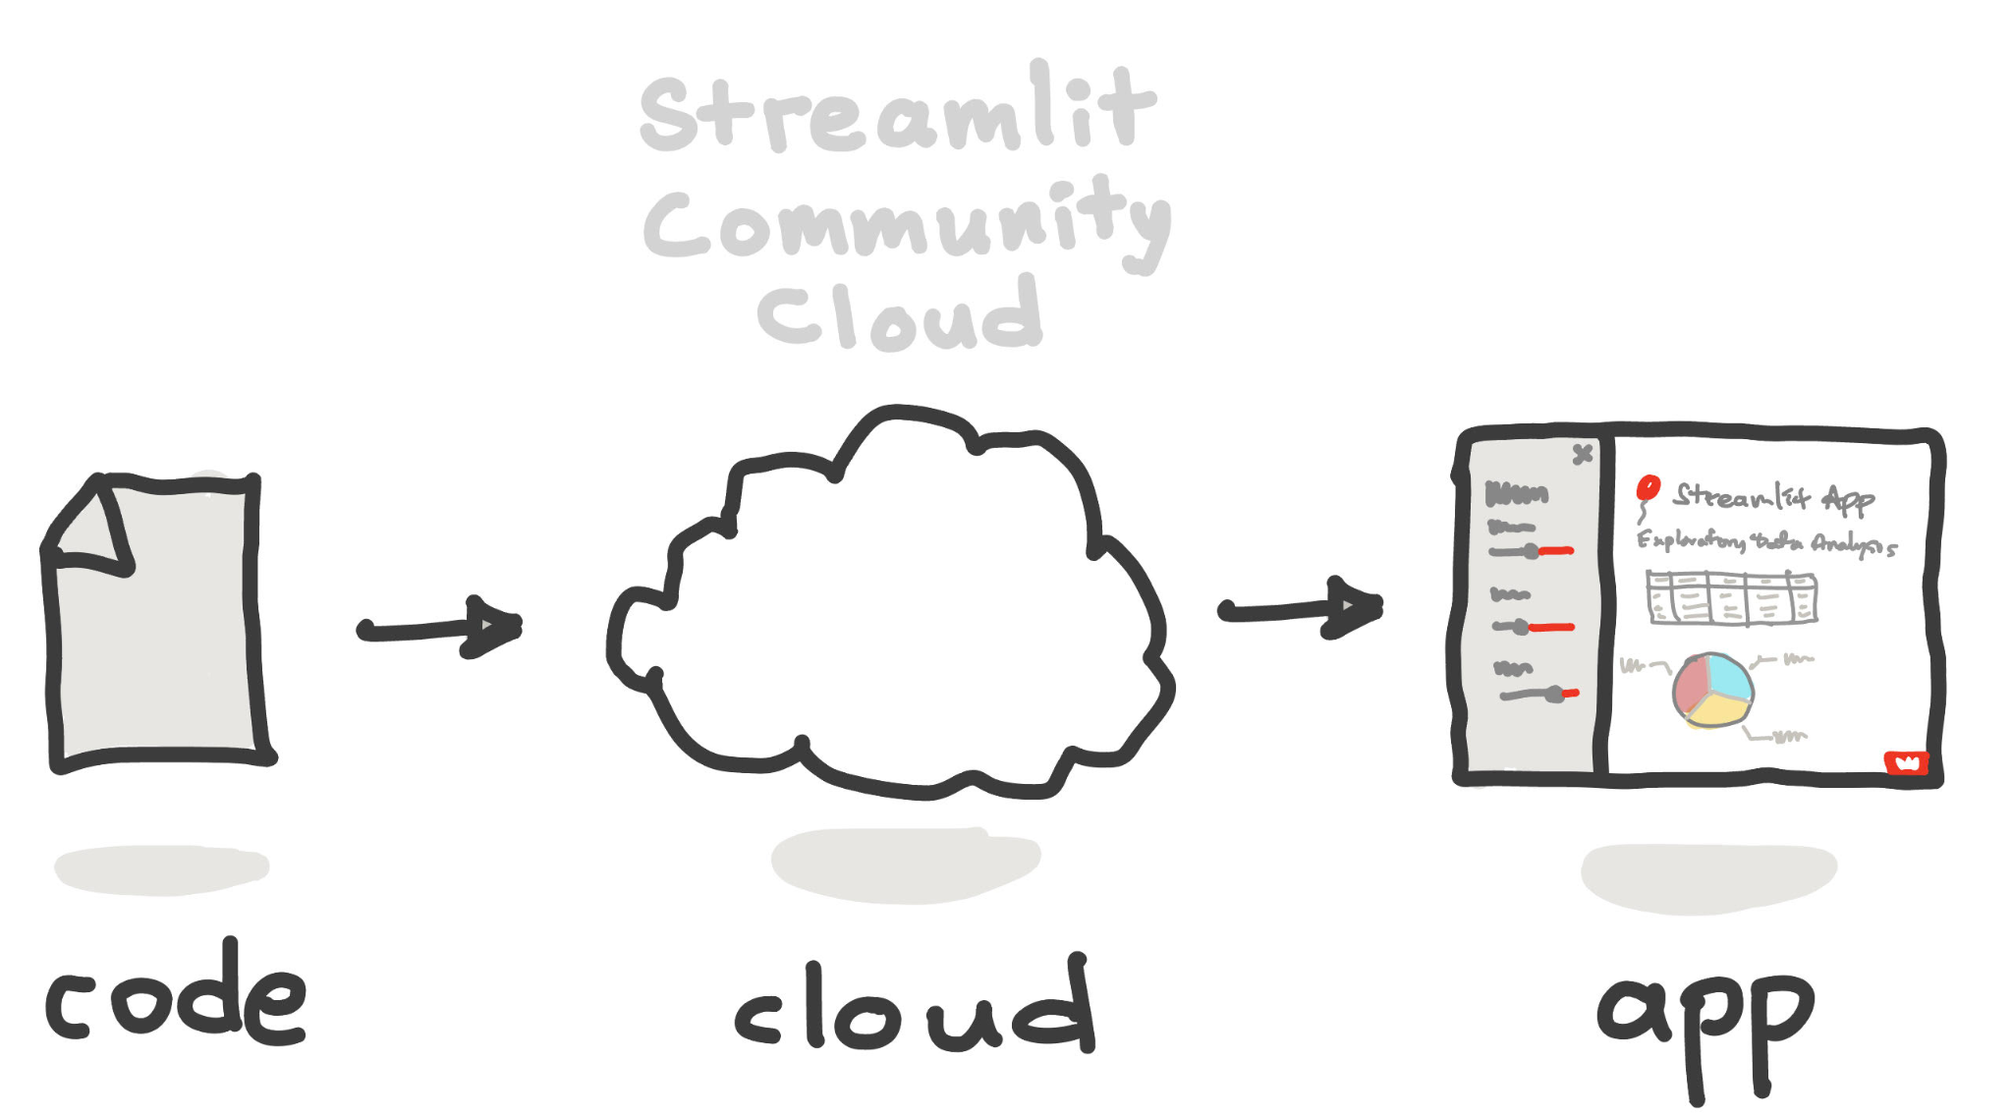
Deploy everywhere!
Streamlit apps can be deployed everywhere:
Locally
Cloud-host
Streamlit Community Cloud
HF Spaces
Self-host
AWS, Azure, GCP, etc.
In-browser
Stlite

Slide 20
Let’s build the
Dashboard

Slide 21
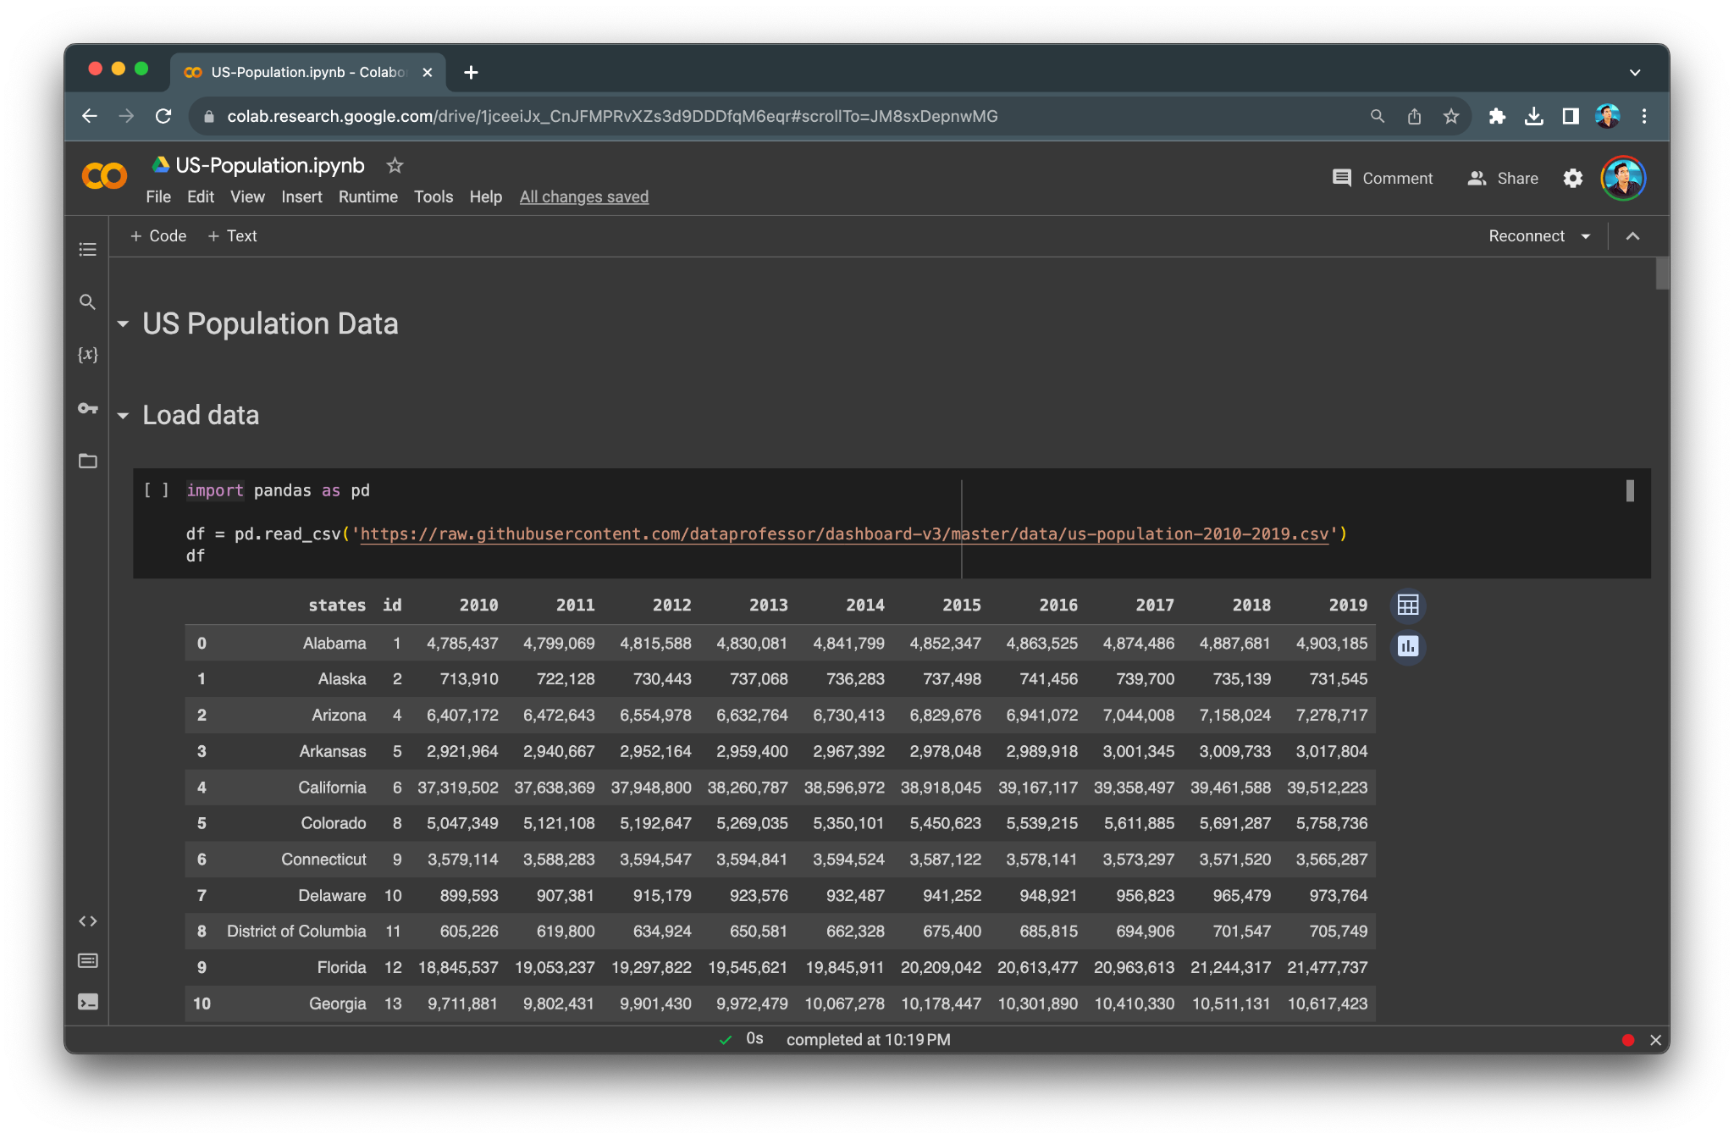
Exploring the data
At the onset, data pre-processing, analysis and visualization were performed in a Colab notebook
At this phase, we want to gain a better understanding of the data
To do this, we first start by importing the CSV data
Notebook available at https://github.com/dataprofessor/dashboard-v3

Slide 22
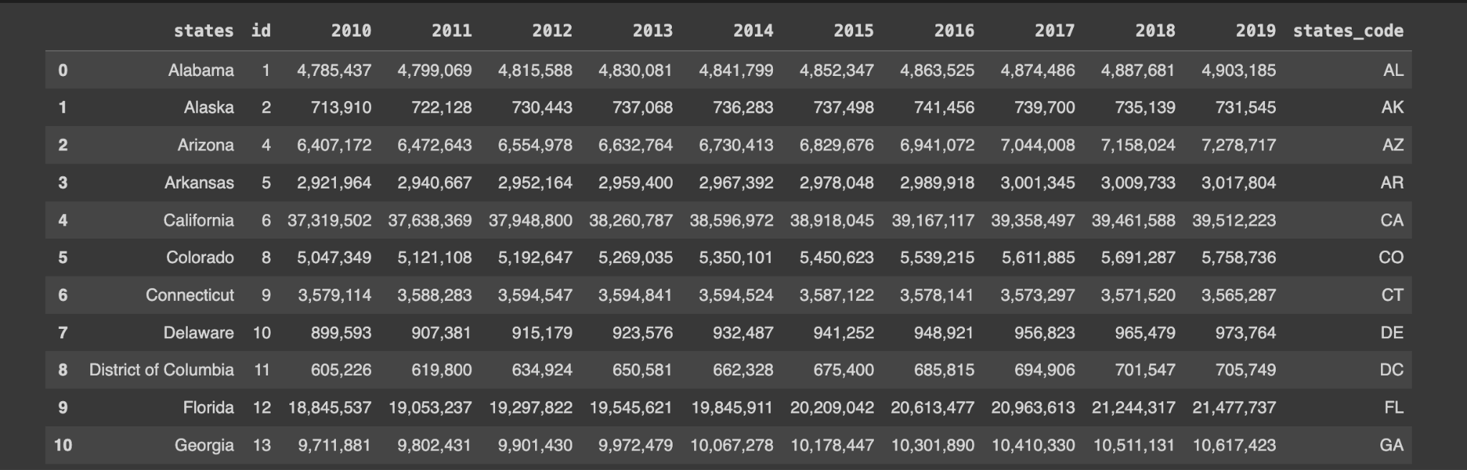
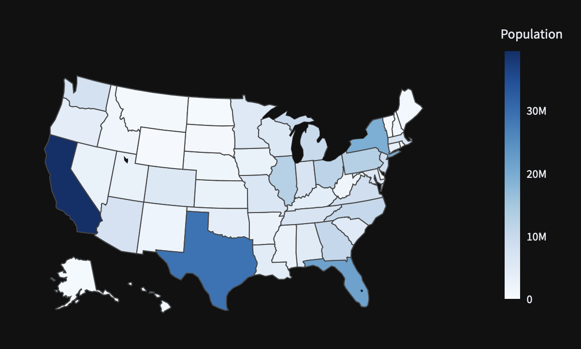
Data pre-processing (1)
Retrieved data from US Census Bureau
Initial data consisted of states and 10 year columns (2010-2019)
id and states_code columns were added for choropleth map

Slide 23
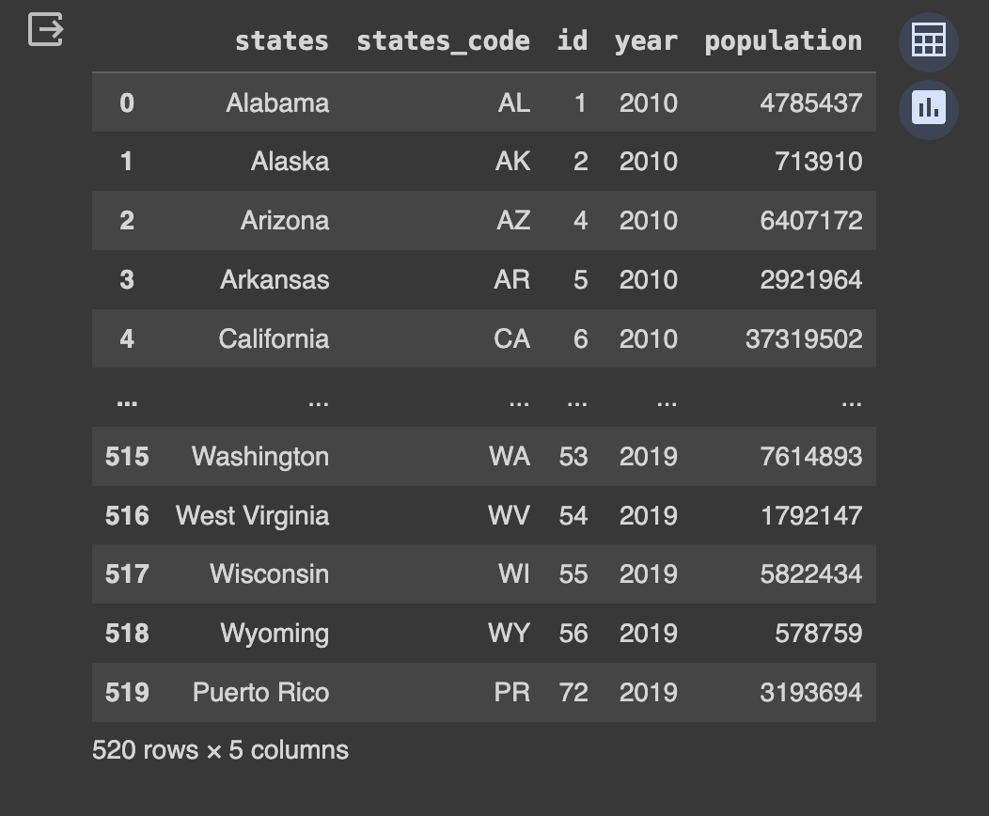
Data pre-processing (2)
Data was reshaped by consolidating the 10 year columns (2010-2019) into a single column called year

Slide 24
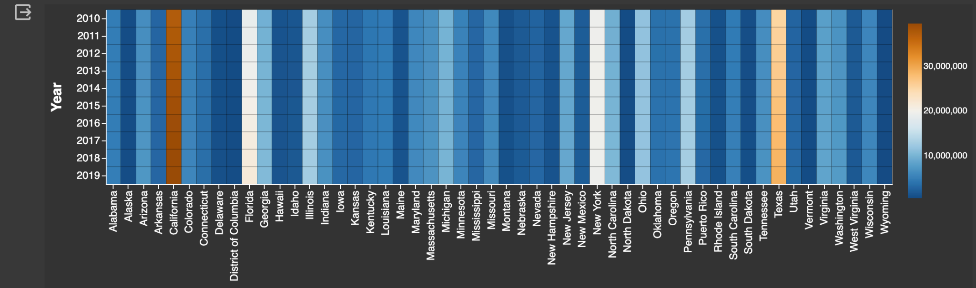
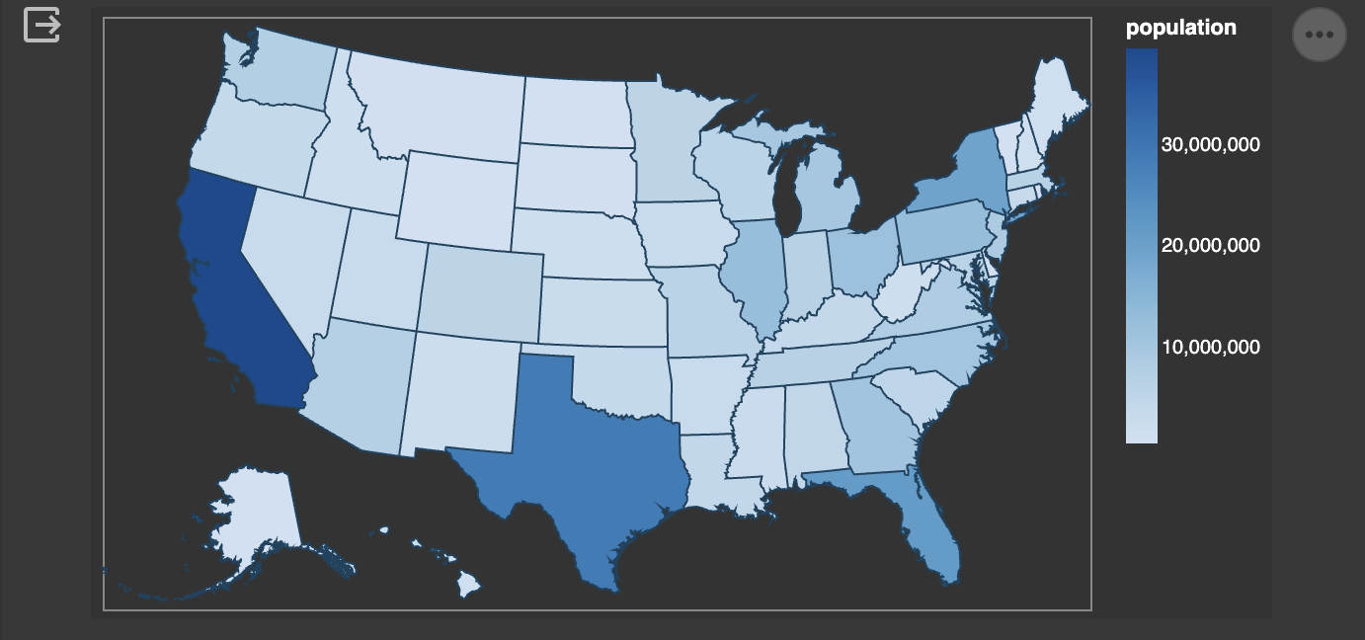
Performing EDA and Data visualization
Here, we’re in experimental phase where we’re trying out various libraries and creating visualizations in an attempt to better understand the data
Altair and Plotly are used for creating the plots used in the dashboard
Plots used in the app:
Heatmap (Altair)
Donut chart (Altair)
Choropleth map (Plotly)

Slide 25
Building the Dashboard
Once we have all the data analysis completed, it’s time to transfer this to our Dashboard
Here, we’re going to implement the Dashboard using Streamlit

Slide 26
The Dashboard app
For this talk, I’ve built a Dashboard app for visualizing the US population data
The data was obtained from the US Census Bureau
App available at https://dashboard3.streamlit.app

